Slide 1
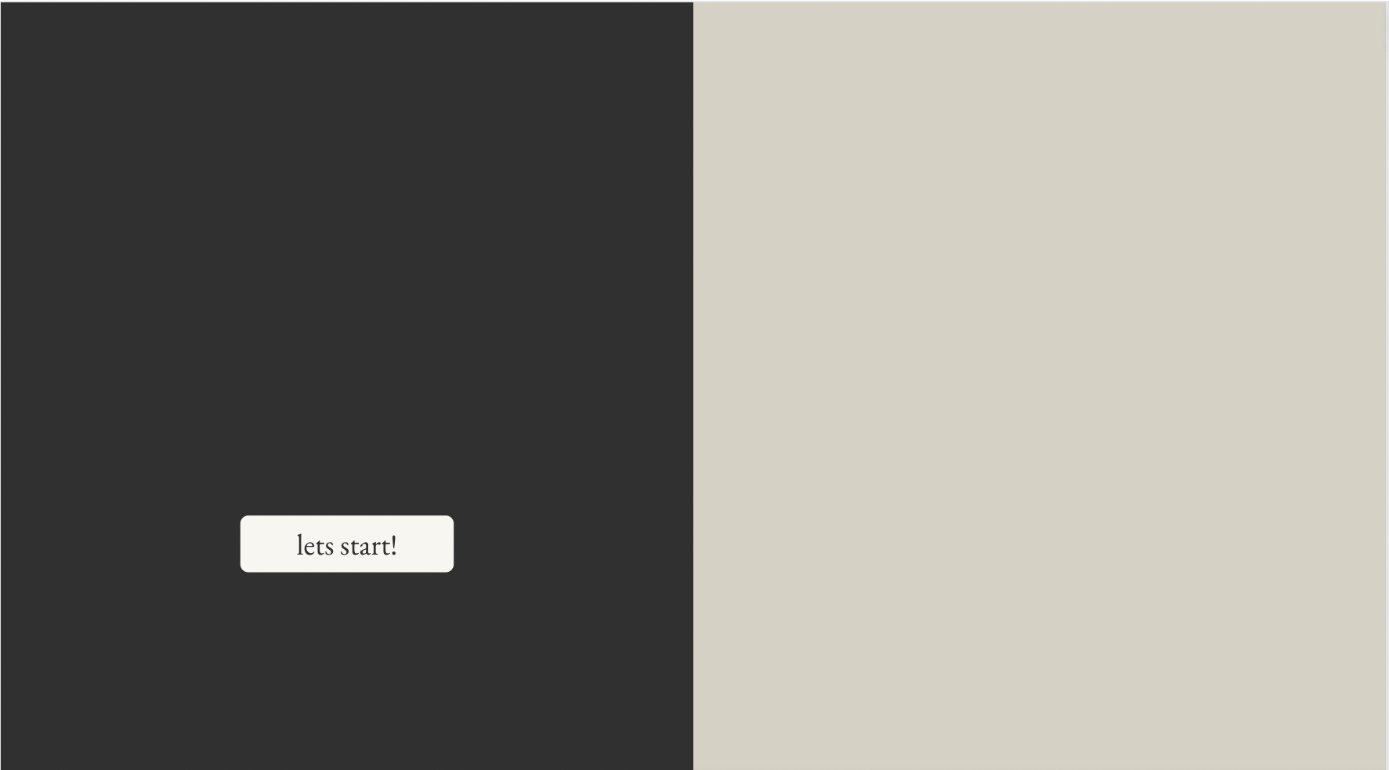

RFM Analysis
(Recency, Frequency ,Monetary)
By Anshika

Slide 2
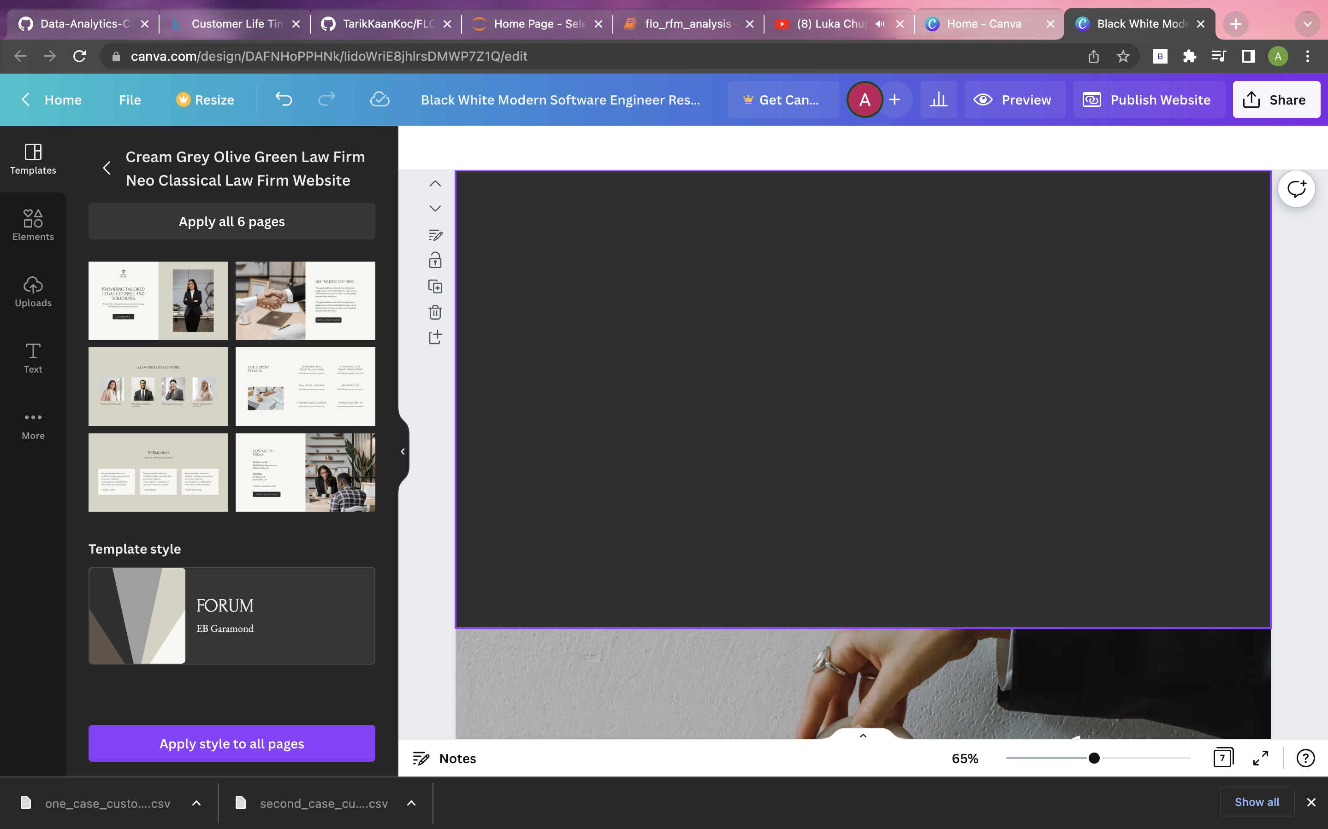
Problem Statement
Segmenting the customers of FLO, an online shoe store, wants to make sense according to these segments. So, We will be analysing Recency of the customer (How recent he/she has purchased ?), Frequency of the customer(How frequent he/she purchases from that shop/business ?) and Monetary(How much money he/she has contributed to the business ?). it will be designed accordingly and will be created according to this particular clustering. FLO, and determine marketing strategies according to these segments.

Slide 3

Data Pipeline
Data - Extraction
Data Visualization
Perform descriptive and exploratory analysis of The data & generate visualizations.
The dataset that is used in this project
a is public but MIT licensed dataset
available from Kaggle
Data Preprocessing
There are 19945 rows and 12 columns
In the data frame, missing values are
Checked, d-types, and new columns
Are created.
RFM ANALYSIS
Rfm metric, rfm score,
And case outputs

Slide 4
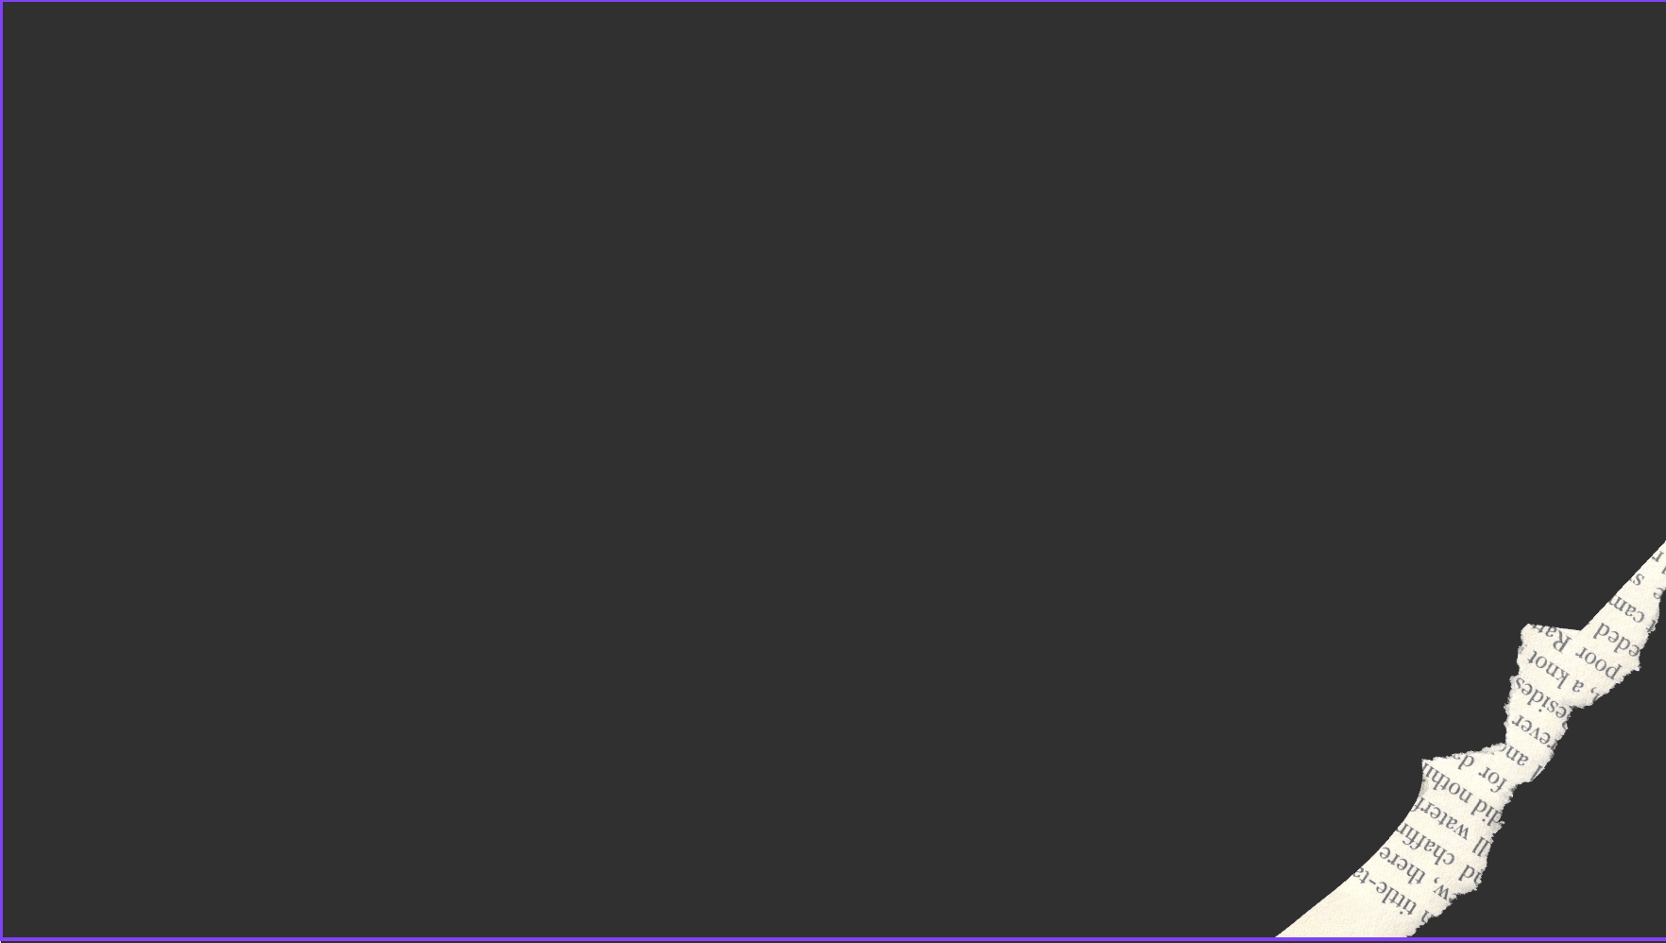
Attributes
Total Features : 12 - Total Row : 19.945 and CSV File Size : 2.7 MB
master_id : Unique Customer Number
order_channel : Which channel of the shopping platform is used (Android, IOS, Desktop, Mobile)
last_order_channel : The channel where the most recent purchase was made
first_order_date : Date of the customer's first purchase
last_order_channel : Customer's previous shopping history
last_order_date_offline : The date of the last purchase made by the customer on the offline platform
order_num_total_ever_online : Total number of purchases made by the customer on the online platform
order_num_total_ever_offline : Total number of purchases made by the customer on the offline platform
customer_value_total_ever_offline : Total fees paid for the customer's offline purchases
customer_value_total_ever_online : Total fees paid for the customer's online purchases
interested_in_categories_12 : List of categories the customer has shopped in the last 12 months

Slide 5

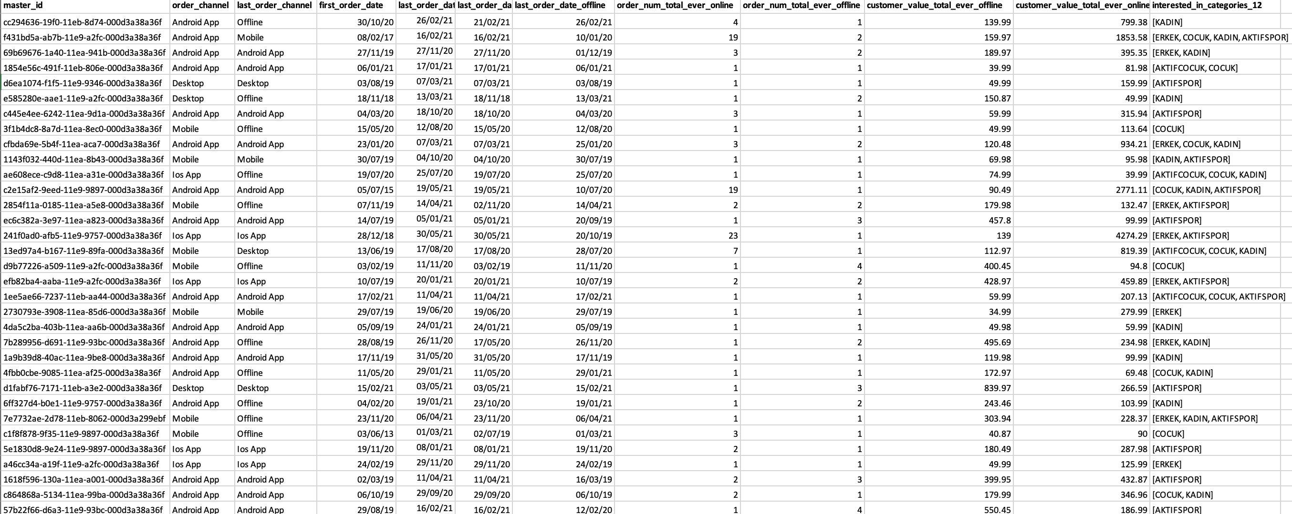
Dataset

Slide 6
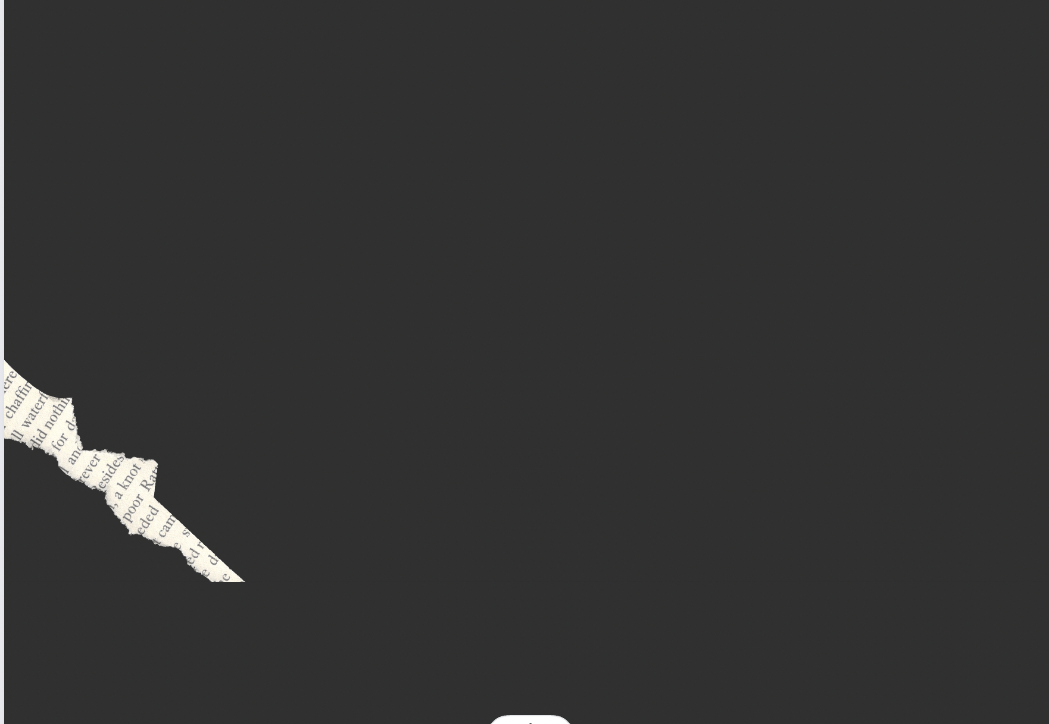

Libraries
Pandas
NumPy
Matplotlib
Seaborn
Datetime
Squarify
ggplot

Slide 7
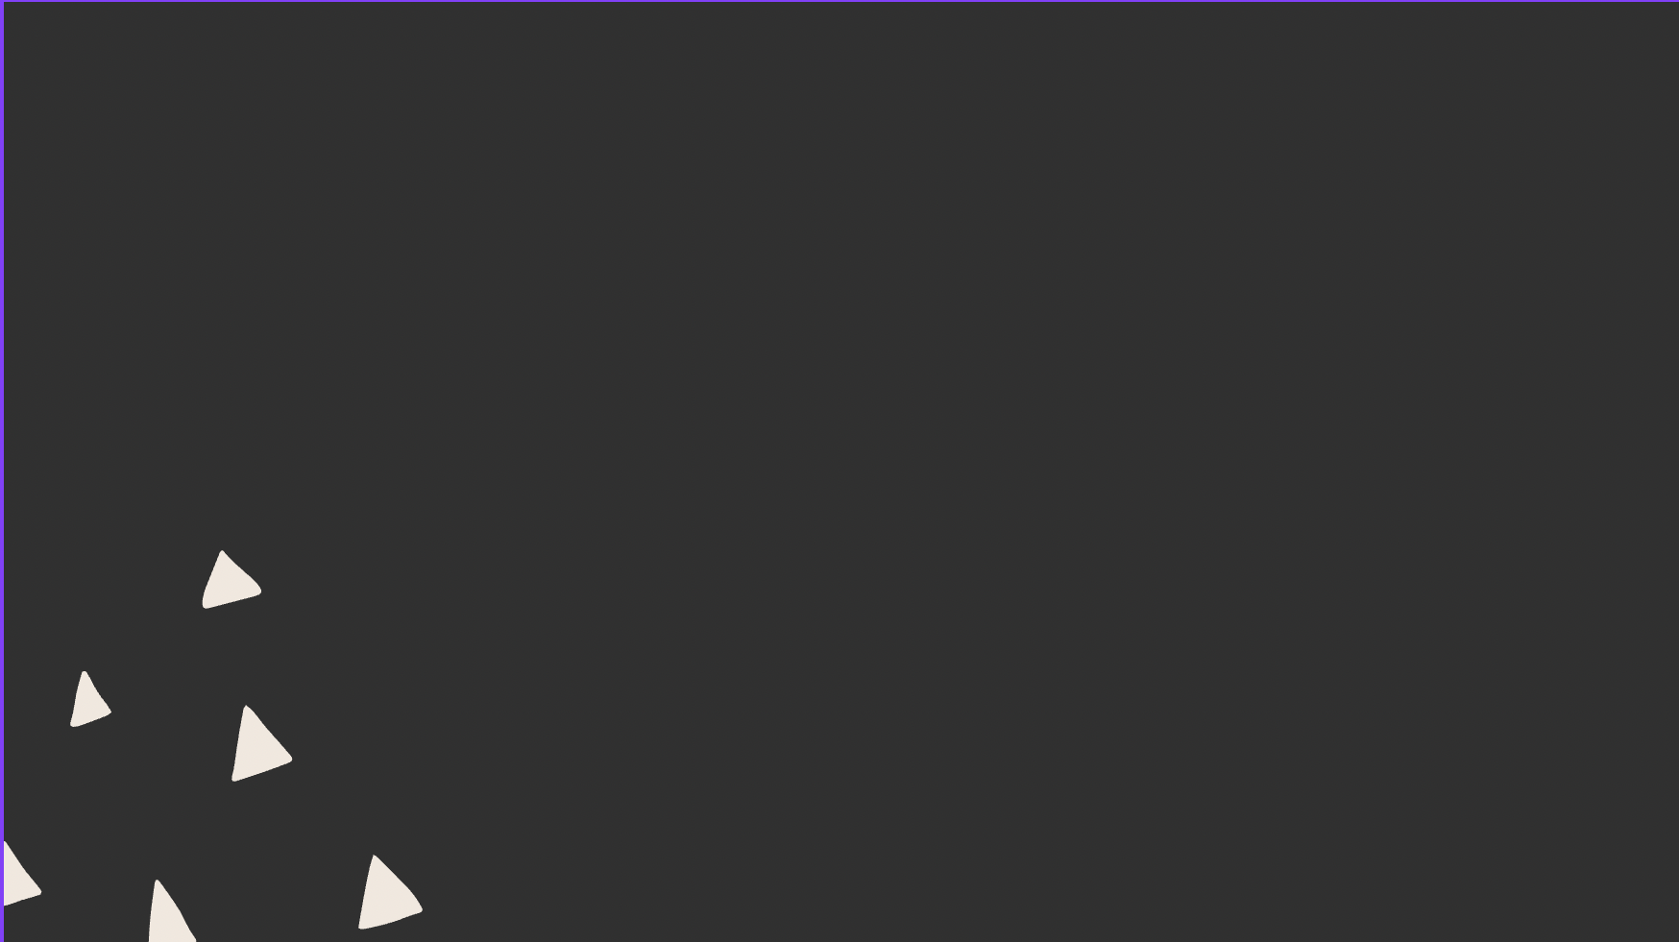
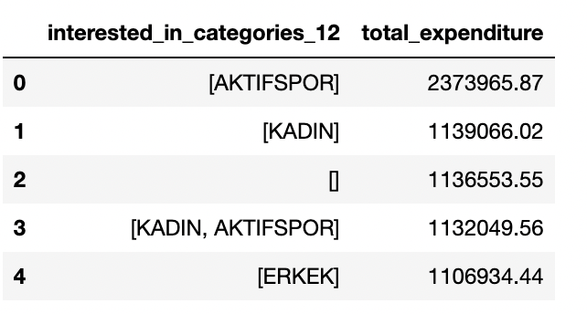
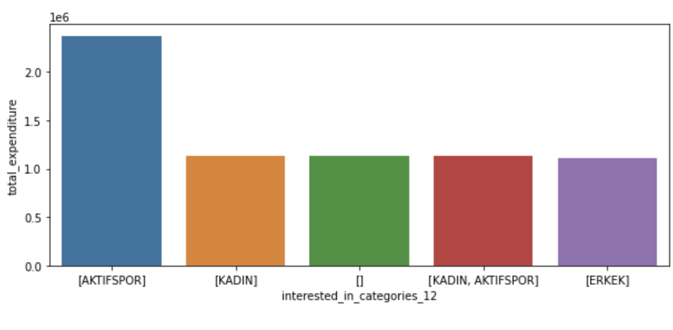
Total Cost Of Purchase Per Year

Slide 8
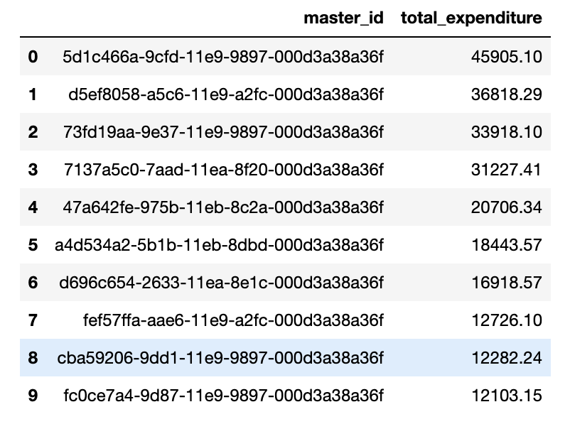
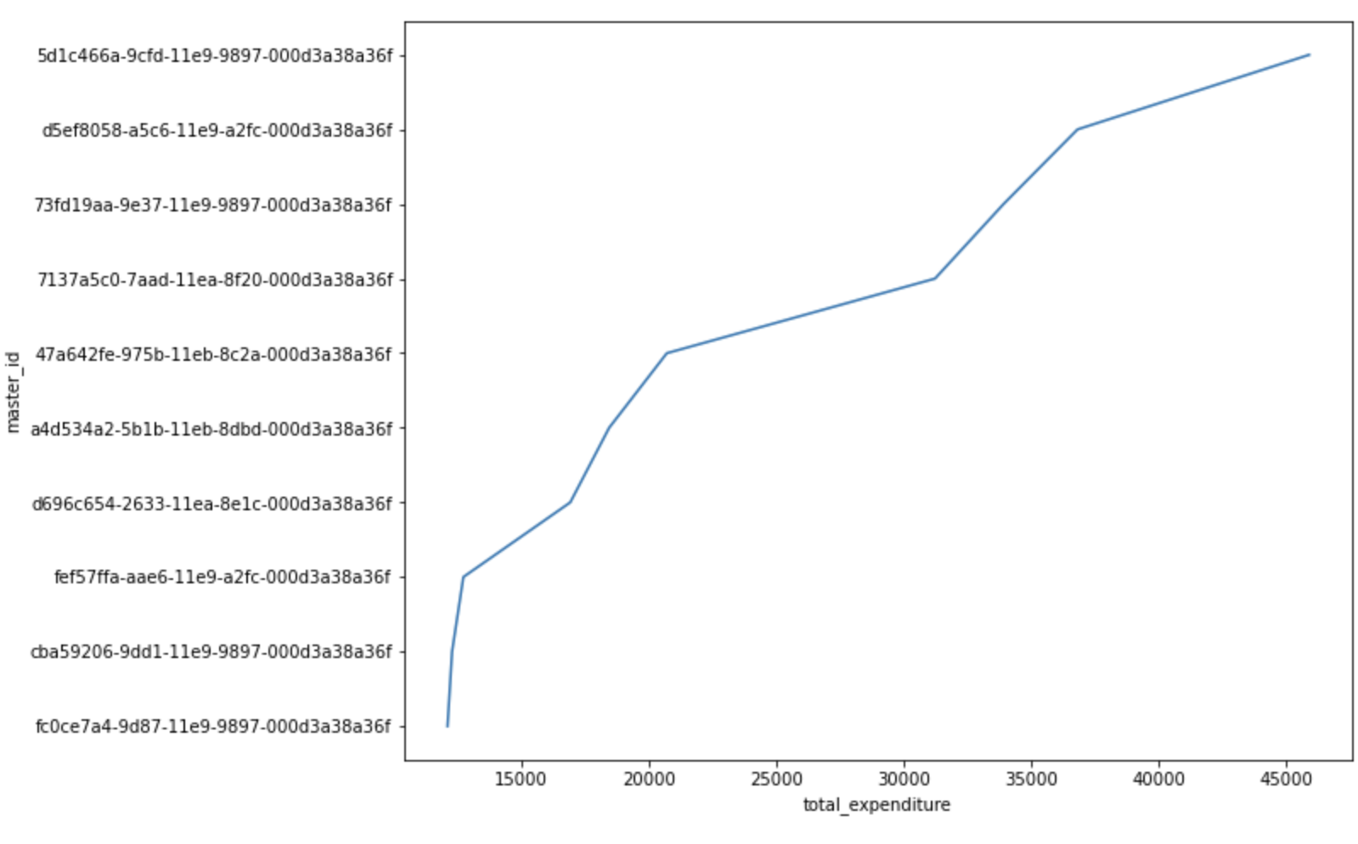
Top 10 shoppers with most revenue

Slide 9

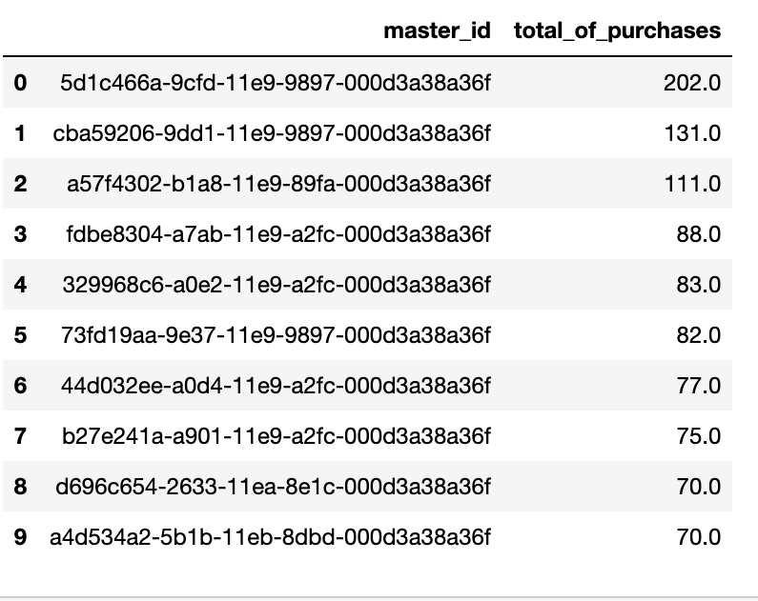
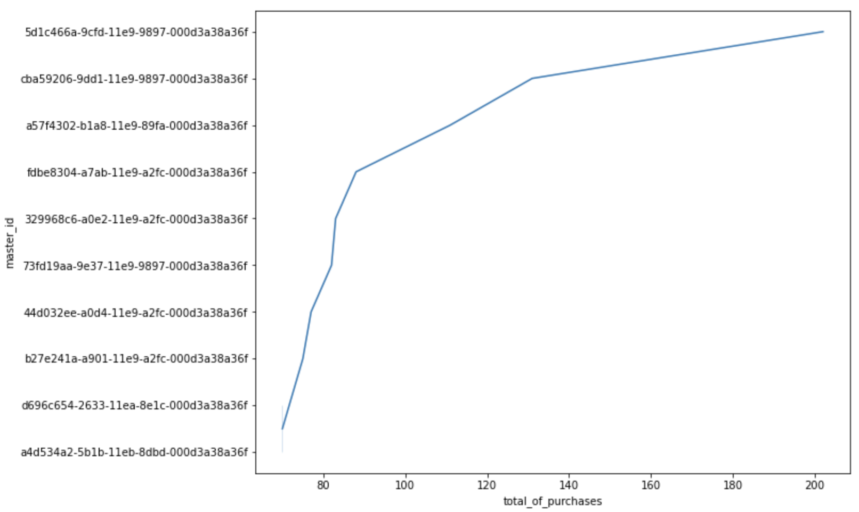
Top 10 customers with the most orders

Slide 10
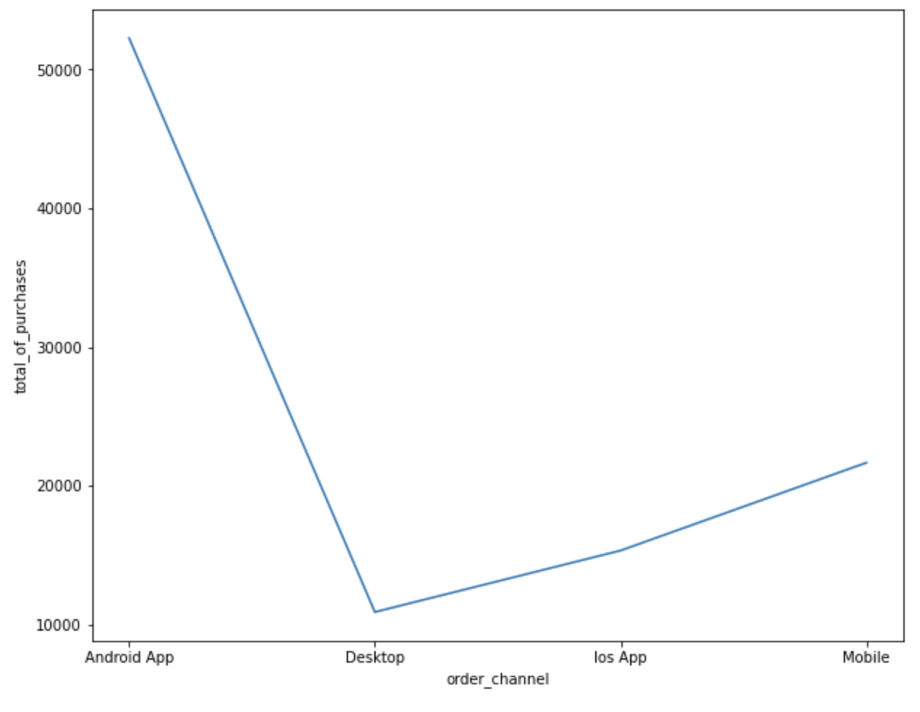
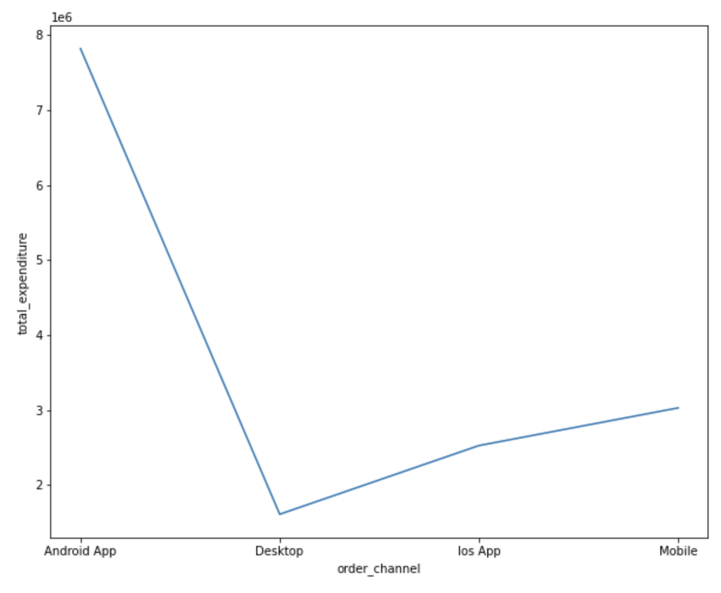
Distribution Of The Number Of Customers In The Shopping Channels
ORDER CHANNEL V/S TOTAL PURCHASE
ORDER CHANNEL V/S TOTAL EXPENDITURE

Slide 11
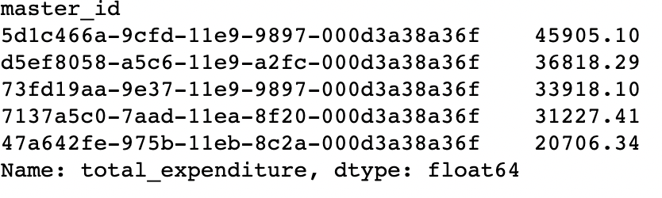
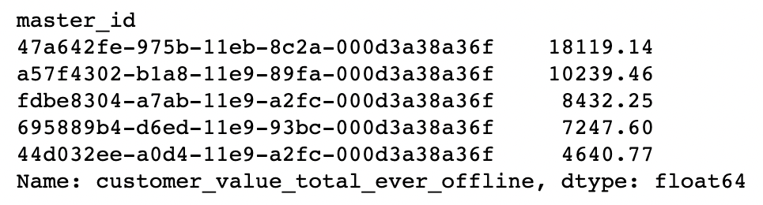
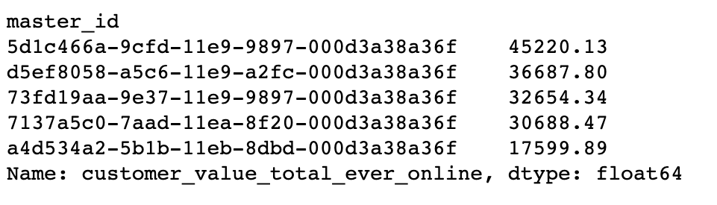
Statistics For Total Spend By Customers
Both Online And Offline
Spend by customers in offline mode
Spend by customers in online mode

Slide 12
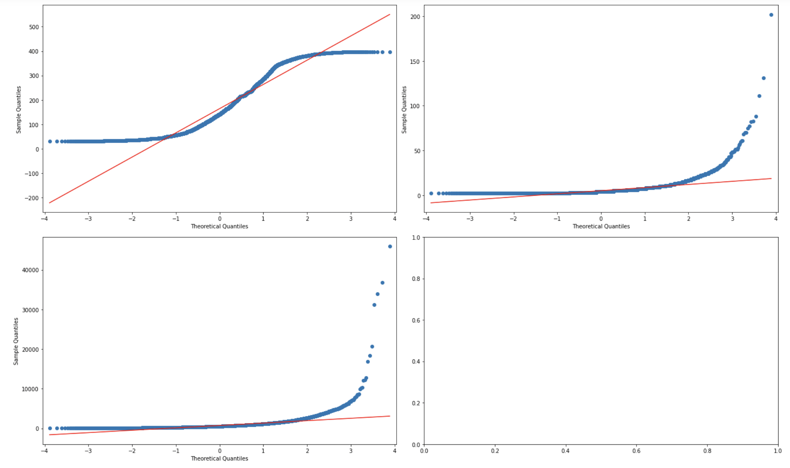
The QUANTILES OF X VERSUS THE QUANTILES/PPF OF A DISTRIBUTION

Slide 13
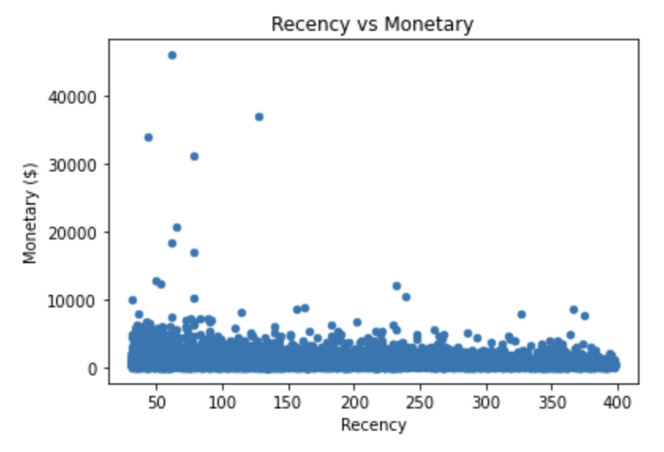
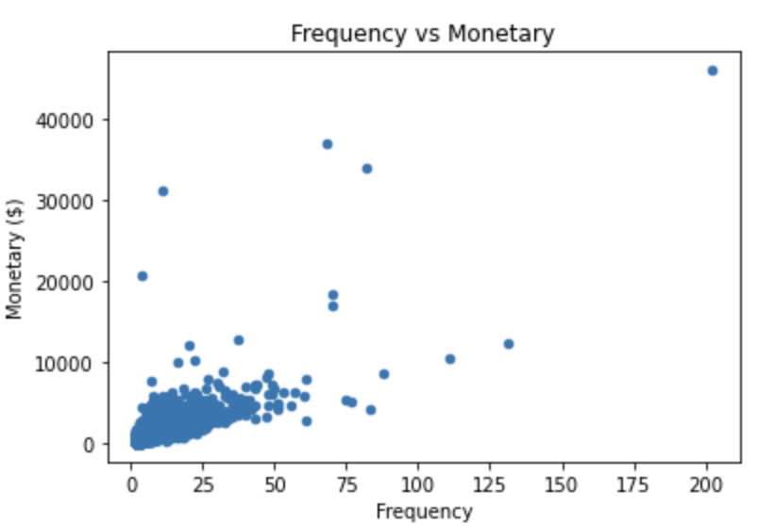
Recency ,Monetary And Frequency

Slide 14
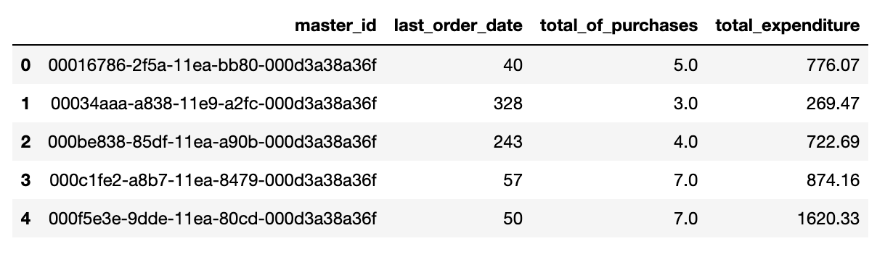
RFM Metrics

Slide 15
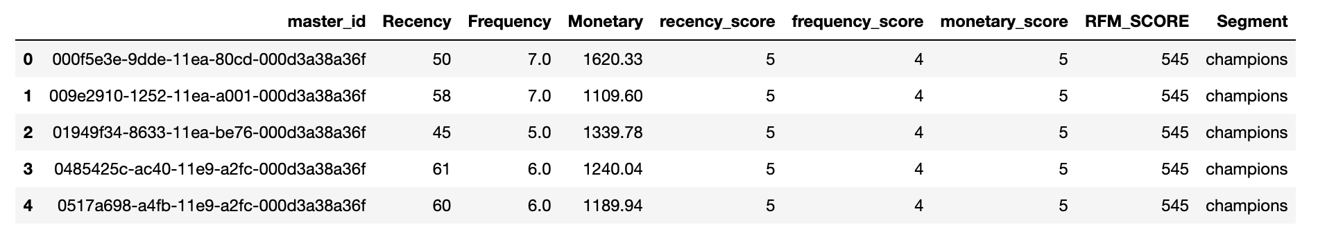
RFM - Score

Slide 16
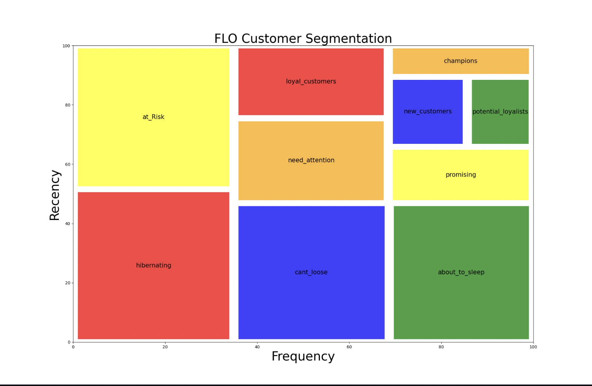
FLO Customer Segmentation

Slide 17
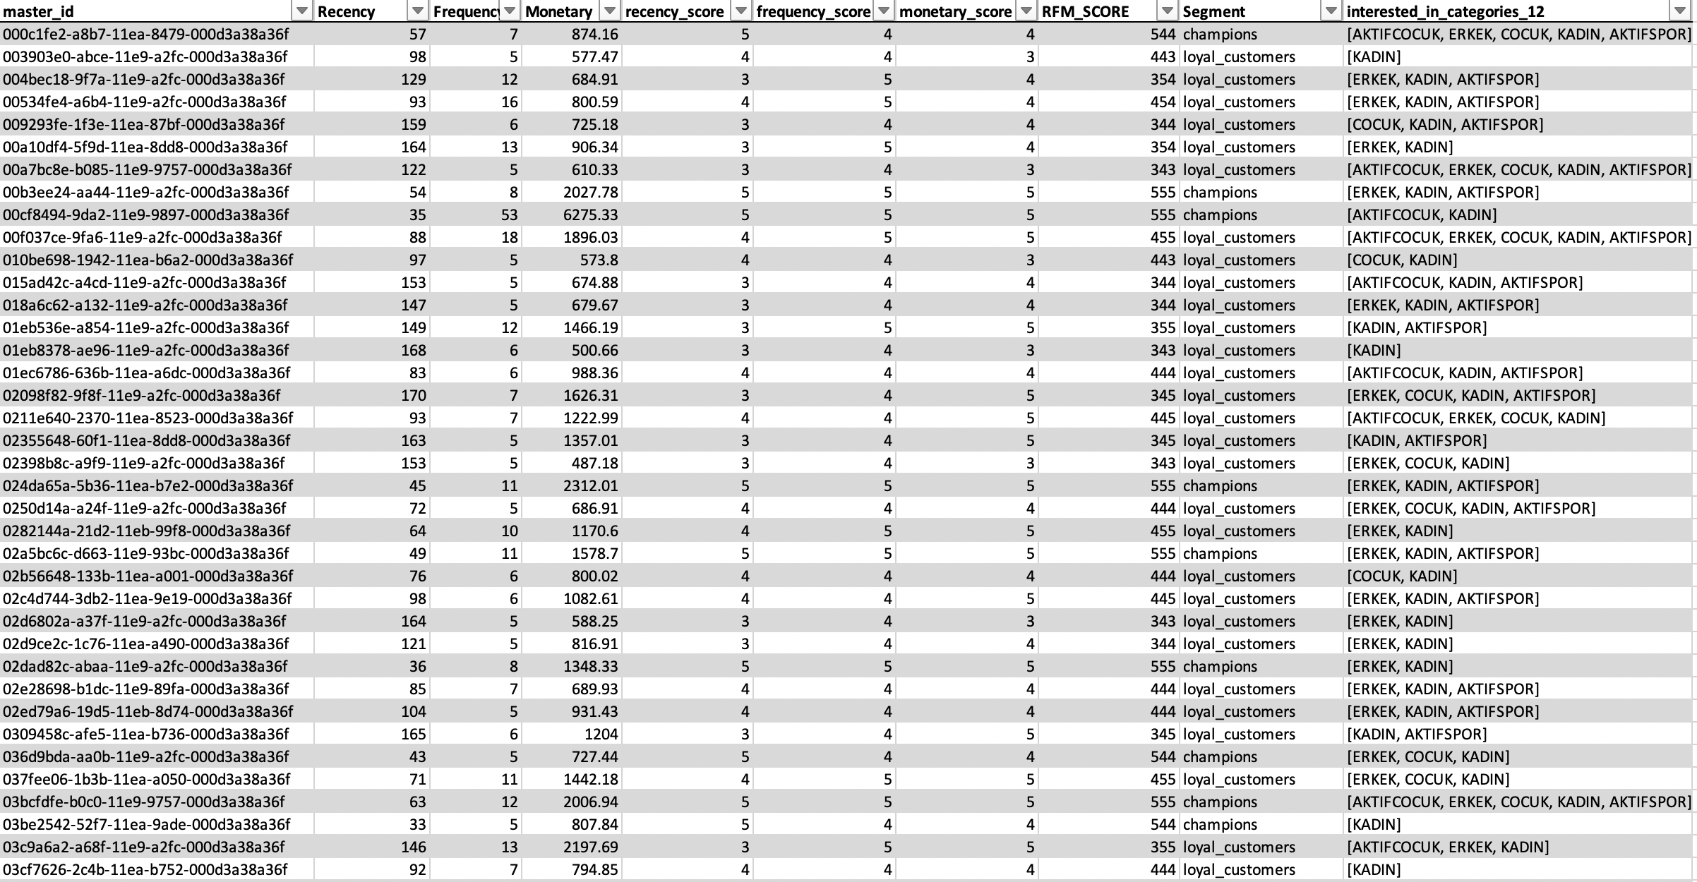
Case-1 New Brand Target Customer Id

Slide 18
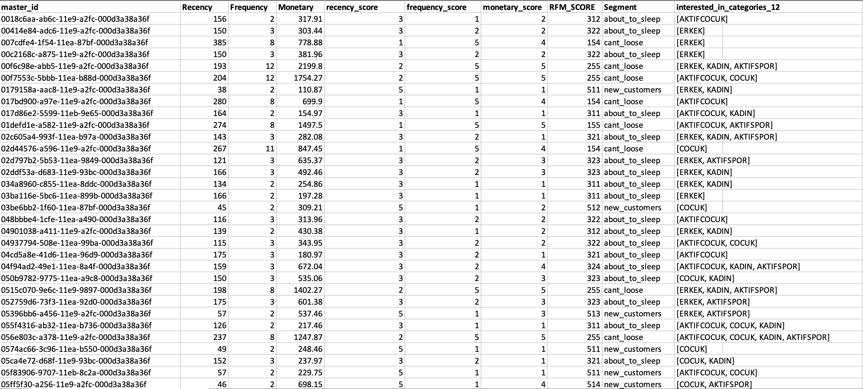
Case-2 Discount Target Customer Ids

Slide 19
Future Scope and Conclusion
Using the RFM model helps a business define interactions with each specific clusters of customer, creating opportunities to increase the relevance of messaging, eventually creating the potential for increased customer lifetime value and thus generate much higher rates of response, plus increased loyalty.
Recency is the most important factor. Why? Because the longer it takes for a customer to return to your business, the less likely he or she is to return at all.
RFM Analysis is the segmentation of customers based on:
Last Purchase
Frequency of Purchase
Overall Expenditure

Slide 20


